Slide 1
Boolean Logic and Boolean Algebra
CSE 4205: Digital Logic Design
Aashnan Rahman
Junior Lecturer
Department of Computer Science and Engineering (CSE)
Islamic University of Technology

Slide 2
01
Binary Logic
Zero or One?

Slide 3
Algebra
A mathematical system, defined with a set of elements, operators and a number of axioms or postulates.
A set of elements : Objects having common properties
Operators : A set of rules defined on the elements.
Postulates : Basic assumptions from where rules, theorems, etc. are deduced.

Slide 4
Binary Logic
Binary Algebra consists of binary variables and set of logical operation
Binary variables take on only one of two possible values –
High or 1
Low or 0
Logical Operations?
AND, OR, NOT, NAND, NOR, X–OR, X–NOR

Slide 5
02
Postulates
Fundamental principle or statement assumed to be true

Slide 6
Postulates
A postulate (also called an axiom) is a basic, foundational assumption that is accepted as true without proof and serves as a starting point for further reasoning or theory-building.

Slide 7
Postulates
1. Closure
A set is said to satisfy closure property if it is closed under an operation or collection of operations.
In other words, A set is closed with respect to binary operation if performance of that operation on the members of the set always produce a result from the same set.

Slide 8
Postulates
2. Associative Law
(x # y) # z = x # (y # z)
for all, x,y,z ∈ S
3. Commutative Law
x # y = y # x
for all, x,y ∈ S
4. Distributive Law
x # (y $ z) = (x # y) $ (x # z)
for all, x,y,z ∈ S

Slide 9
Postulates
5. Identity
x # e = e # x = x
for all, x,e ∈ S
6. Inverse
x # y = e
for all, x,y,e ∈ S

Slide 10
History
In 1854, George Boole introduced systematic treatment of logic and developed Boolean algebra.
In 1938, C. E. Shannon materialized a two-level Boolean algebra. Also called switching circuit/algebra.
For formal definition of Boolean algebra, we follow the postulates formulated by E. V. Huntington (1904).
Boolean algebra is a field (implementation of algebraic structure) with a set of elements B, together with two binary operators (+) and (.) and follows the Huntington postulates.

Slide 11
Huntington Postulates
1. a. Closure with respect to binary operator +
b. Closure with respect to binary operator .
2. a. An identity element with respect to +, is designated by 0 :
b. An identity element with respect to ., is designated by 1 :
3. a. Commutative with respect to + :
b. Commutative with respect to . :
4. a. . is Distributed over + :
b. + is Distributed over . :

Slide 12
Huntington Postulates
5. For every element x ∈ B there exists an inverse element x’ ∈ B (complement of
B) such that :
6. There exists at least two elements x,y ∈ B such that:

Slide 13
Boolean Algebra vs Ordinary Algebra
Huntington postulates do not mention associative law, but it holds here.
Distributive law of (+) over (-) is only valid for boolean algebra but not ordinary algebra.
No existence of additive or multiplicative inverse in boolean algebra.
No existence of division or multiplication in boolean algebra either.
Complement is only available in Boolean algebra.
For boolean algebra, x ∈ B where B = [0,1]
For ordinary algebra, x ∈ R

Slide 14





Postulates
Laws | Examples
Identity Laws
Idempotent Law
Complement Law
Commutative Law
Associative Law
Distributive Law

Slide 15




Postulates
Laws | Examples
Double Negation
Absorption Law
De Morgan’s Law

Slide 16
Duality
Every algebraic expression deducible from the postulates of the Boolean algebra remains valid if the operators and identity elements are interchanged.

Slide 17
Self-Dual
If the dual expression = the original expression.
Find the dual of the following expressions, and determine if its there is a self dual.
F = (A + C) · B + 0
Ans : A · C + B
2. G = X · Y + (W + Z)
Ans : (X+Y) · (W · Z)
3. H = A · B + A · C + B · C
Ans : (A + B)(A + C)(B + C)

Slide 18
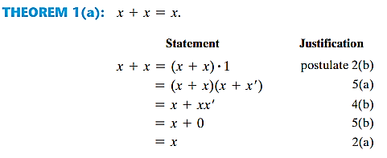
Proof of Basic Theorems

Slide 19
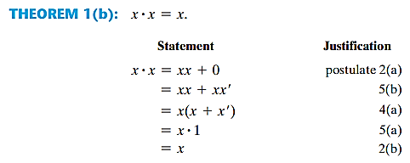
Proof of Basic Theorems

Slide 20
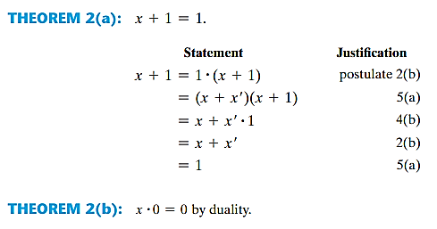
Proof of Basic Theorems

Slide 21
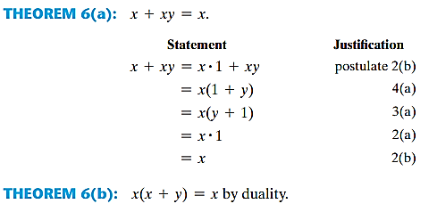
Proof of Basic Theorems

Slide 22


De-Morgan’s Law
The complement of a sum is the product of the complements.
The complement of a product is the sum of the complements.

Slide 23
03
Truth Table
Time for the truth (table)

Slide 24
Truth Tables
A truth table shows all possible input combinations of Boolean variables and their corresponding output for a given Boolean expression.
For n inputs, there will be 2^{n} possible input and output combinations.

Slide 25
Proof using Truth Tables
Absorption Rule :
A | B | AB | A+AB
0 | 0 | 0 | 0
0 | 1 | 0 | 0
1 | 0 | 0 | 1
1 | 1 | 1 | 1

Slide 26
Proof using Truth Tables
De-Morgan’s Law :
A | B | A+B | (A+B)’ | A’ | B’ | A’B’
0 | 0 | 0 | 1 | 1 | 1 | 1
0 | 1 | 1 | 0 | 1 | 0 | 0
1 | 0 | 1 | 0 | 0 | 1 | 0
1 | 1 | 1 | 0 | 0 | 0 | 0

Slide 27
04
Boolean Algebra
The Logic Behind Every Digital Decision

Slide 28
Operator Precedence
Parentheses
NOT
AND
OR

Slide 29

Boolean Functions
A Boolean function is a mathematical expression that takes binary inputs (0s and 1s) and produces a binary output (0 or 1) using Boolean operations.

Slide 30
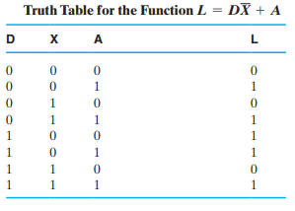
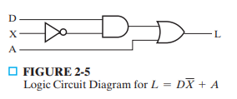
Boolean Functions

Slide 31
05
Circuit Diagram and Simplification
Let’s keep things simple

Slide 32
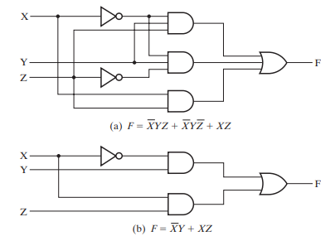
Boolean Functions

Slide 33
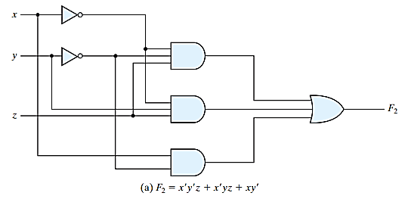

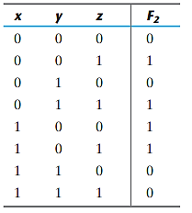
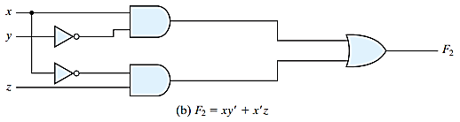
Boolean Functions

Slide 34



Boolean Functions
For practice
1. X + XY = X
2. XY + XY = X
3. X + XY = X+Y
4. X(X+Y)=X
5. (X+Y)(X+Y)= X
6. X (X+Y)=XY
7.
8.
Worksheet 1: https://web.mit.edu/6.111/www/s2007/PSETS/pset1.pdf
Worksheet 2: https://uomustansiriyah.edu.iq/media/lectures/6/6_2024_04_04!02_36_02_PM.pdf

Slide 35


Algebraic Manipulation
In any Boolean expression,
– A Term is represented by a gate with inputs.
– Each literal/variable within a term designate an input in primed or unprimed form.
For example
3 terms, 8 literals
2 terms, 4 literals

Slide 36




Complement
Interchanging the output of function F produces F’.
Methods
Apply De-Morgan’s Law
2. Complement each literal and take its dual

Slide 37
Thank You !!
Feel free to ask any questions

